Slide 1
NETWORK SIMULATION SOFTWARE: ANALYSIS of ALTERNATIVES
JUSTIN MCCANNON
NIDHI MARSONIA
MICHAEL MCINNIS
TIFFANY NGUYEN
AZM UDDIN

Slide 2
Project Goal
Reseach Available Network Simulators
Find the best for class use
Create a guide for the chosen simulator

Slide 3
Simulator Selection
Cisco Packet Tracer
GNS3
EVE-NG
Cisco Modeling Labs

Slide 4
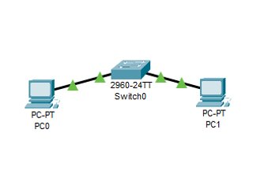
Testing Methodology
Create a list of requirements
Have requirements ranked by project sponsor
Build simple networks in simulators to test requirements.
Screenshot of Cisco Packet Tracer

Slide 5
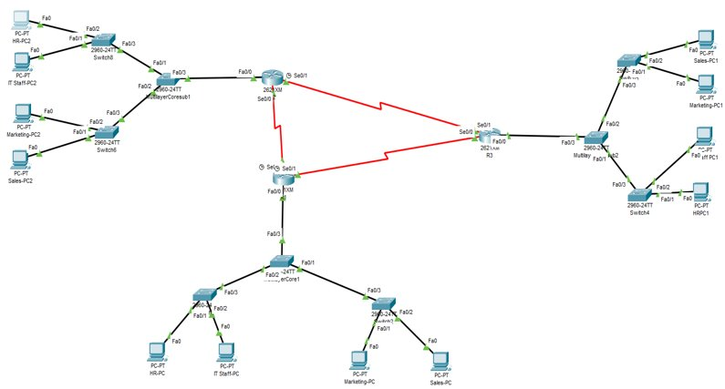
Cisco Packet Tracer
Free of cost – only requires a Cisco Academy account.
Low System Requirements and multi-platform
Device Variety
Supports Majority of Networking protocols
Realistic Network Behavior
Multiuser Support
Easy to use
Fig: Topology created in Packet Tracer for testing
Notes:
Notes:
Free of cost – only requires a Cisco Academy account.- Cisco Packet Tracer is free to download for learners by signing up for a free Cisco Networking Academy Account.
Low System Requirements and multi-platform - Secondly, it has low system requirements and runs on multi platform on Microsoft Windows, Ubuntu, or Mac OS 10.12 or newer with low system requirements of 4GB of free RAM and 1.4 GB of free disk space.
Device Variety- whereas most users will use the standard set of routers, switches, and access points, Packet Tracer supports a wide range of devices. That includes ISR 4321 router,1941 Router,2901 router, and 2911router and many more types of switches, ASA firewalls, etc
Supports Majority of Networking protocols- Some Protocals at application are FTP, NTP MQTT, at transport layer are TCP,UDP,RTP, at network layer are IPv4, IPv6, GRE VPN and lastly at network access/interface layer are HDLC, VTP, RSTP etc
Realistic Network Behavior - Packet Tracer allows the user to connect the computer to other devices via a console cable and then configure the device through the PC's terminal. It lets the user simulate the network like in the real world by providing robust network simulator sandbox.
Multiuser Support- enables multiple users to collaborate in real time.
Easy to use - Lastly, it uses drag and drop user interface to make topologies. The components are divided in menu bar, main toolbar, logical and physical workspace tabs, common tool bar, real-time/simulation tabs , device type selection box and so on to make the learning more interactive and engaging.

Slide 6
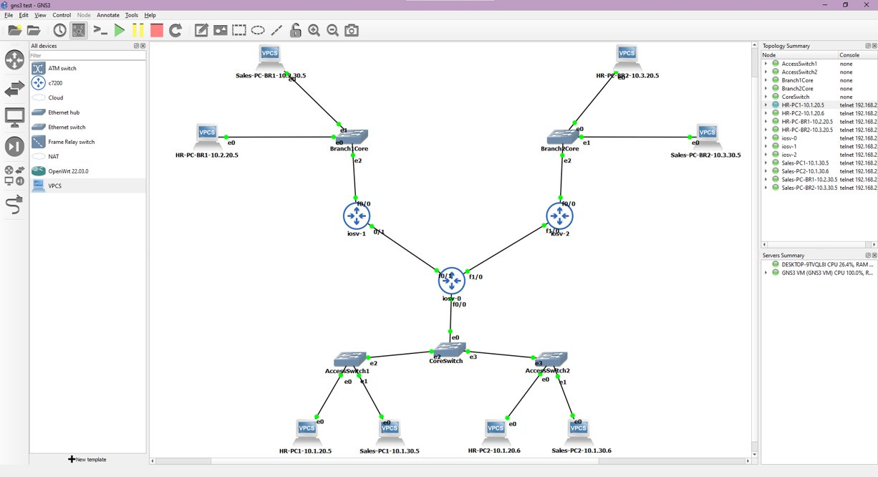
GNS3
Good pricing – free to download
Needs Cisco IOS images to have proper functioning features
Not ideal to use in the classroom due to not being able to use Cisco IOS images without breaking Terms of Service
Also has high system requirements
Great community documentation and learning tools on their website

Slide 7
EVE-NG
Well known Network Simulator
Version
Features
Supported devices

Slide 8
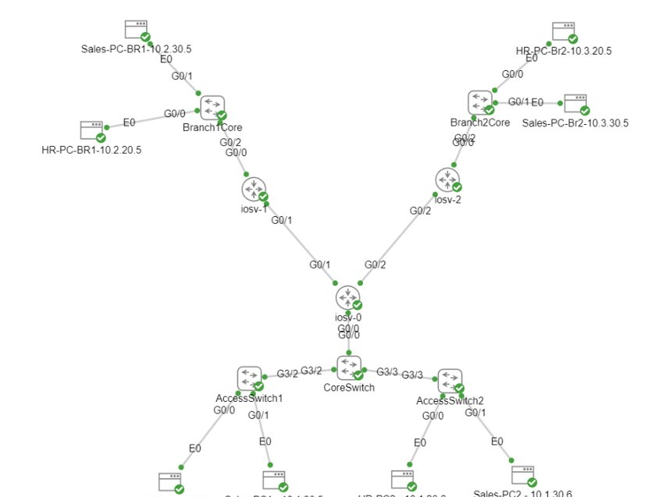
Cisco Modeling Labs
Comes with images for several Cisco products
Comes with images for several Unix/Linux endpoints
Limited number of switchports
Limited to 20 nodes (any type of device)
Individual license starts at $200

Slide 9
Ranking Methodology
Each requirement given a score out of 10
Requirements and scores mapped to vectors
Cosine Similarity used to rank each simulator against requirements.
This Photo by Unknown author is licensed under CC BY-SA.

Slide 10
Final Rankings

Slide 11
Simulator Guide Plan
Basic Switching
IPv4 Routing
Introduction
Advanced Switching
IPv6 Routing

Slide 12
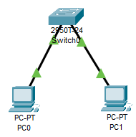
Intro to Packet Tracer and Cisco CLI
Install from Netacad website
Drag and Drop feature to add nodes and connecting nodes to create a topology
Cisco CLI Modes
User EXEC
Privileged EXEC
Configure
Interface Config
Virtual PC Config
Adding IP address
Basic Networking Command
Notes:
Note:
Install from Netacad website- Easily installable from Netacad website in few simple steps.
Drag and Drop feature to add nodes and connecting nodes to create a topology- Secondly, User interface has drag and drop feature to add routers, switches, PC etc to build network topology and help students learn the principles of networking with hands on training.
Cisco CLI Modes - The Cisco IOS command-line interface is used for configuring, monitoring, and maintaining devices which is divided into different mode.
User EXEC - Is the default mode used to change the terminal setting, display system information, and to perform Basic test.
Privileged EXEC - This command allows the user to access all the commands and is password protected.
Configure- Users can edit the running system configuration in Global Configuration mode.
Interface Config- is used to configure parameters for the Ethernet ports.
Virtual PC Config
Adding IP address- is done by assigning IP address, default gateway, subnet mask.
Basic Networking Command- IPCONFIG- HOSTNAME- PING-IPCONFIG /ALL - IP ADDRESS- PASSWORD- Login commands and many more.

Slide 13
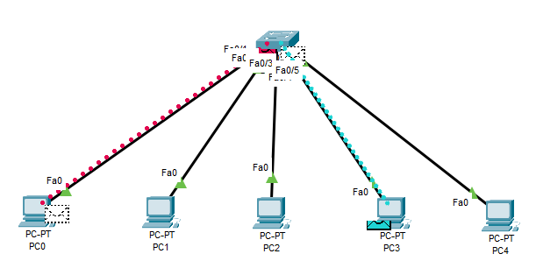
Basic Switching
Switches are network devices used to divide networks into subnetworks called subnets or LAN segments
They operate on the data link layer (layer 2) by forwarding information based on the destination MAC address
Just connect a few PCs to a switch and send some packets to and from different PCs

Slide 14
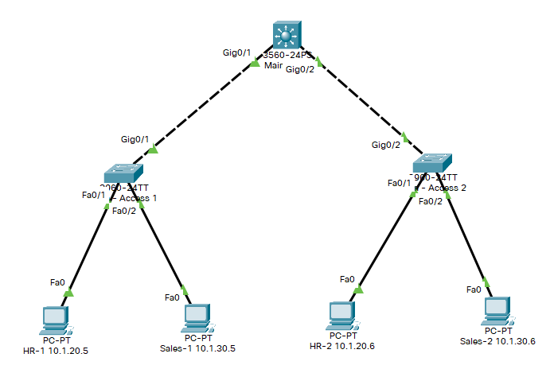
Advanced Switching
Create VLANs to subdivide network
1
Enable 802.1q trunking to pass VLANs between switches.
2
Enable Inter-VLAN routing on the core switches.
3

Slide 15
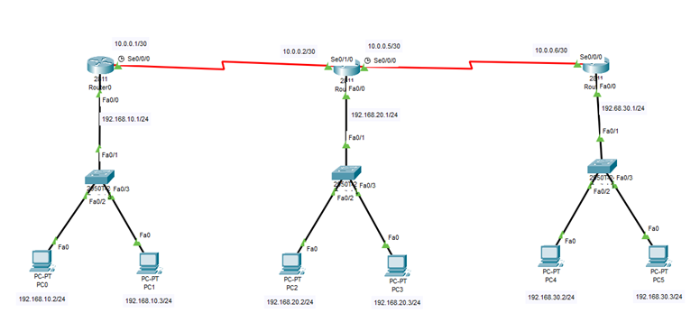
IPv4 Routing
IPv4 Static Routing will occur in the absence of communication between routers regarding the current topology of the network and thus, manually configuring routes to the routes table on the switch is recommended.
It's not possible to configure a static route through a directly‑connected IP subnet where the device gets its IP address from a DHCP server.

Slide 16
IPv6 Routing
Why IPV6?
Features of IPV6
Types of IPV6

Slide 17
Project Management
GroupMe
Microsoft Teams
Microsoft Project
Office 365
Hugo

Slide 18
Challenges
No true in-person communication
Occasional Scheduling conflicts

Slide 19
Final Reflections
Team gained valuable networking and project management experience
Packet Tracer would be an excellent tool for classroom use at KSU

Slide 20
Conclusion

