Slide 1
Network Simulation Software Analysis of Alternatives
IT-4983 Capstone
Fall 2022
Milestone Report 1
Justin McCannon, Nidhi Marsonia, Michael McInnis, Tiffany Nguyen, Azm Uddin

Slide 2
Project Summary
On track to complete all Milestone 1 objectives
Create list of requirements – Complete
Compile list of potential candidates – Complete
Research features of potential candidates – Complete

Slide 3
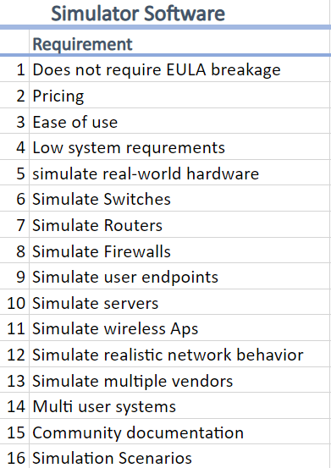
Details for each Objectives
On track to complete all Milestone 1 objectives
Create list of requirements – Complete
Compile list of potential candidates – Complete
Cisco Packet Tracer, GNS3 EVE-NG and NS3
Research features of potential candidates – Complete
Notes:
Objective of milestone 1 includes
compilation of list of 16 requirements such as pricing, ease of use, multiuser systems, Simulate Firewalls, Simulate user endpoints and so on. This will be used to do vector calculation by the sponsors.
image on the right displays all the requirements
Secondly, we have chosen Cisco packet tracer, GNS 3, EVE NG and NS 3 as potential candidate participating in this network simulation software analysis from the pool of candidates based on research .
lastly we will look into the distinctive trait or a special attraction the candidates offer in brief

Slide 4
Cisco Packet Tracer
Cisco Packet Tracer is free network simulator software(requires login on Cisco Networking Academy)
Can simulate the functions of Cisco networking equipment
Simulation of networking traffic and protocols TBD
Supported OS- Windows, macOS, Linux
Mobile version with limited features also available.

Slide 5
GNS3
Free. Requires a GNS3 account.
Need to install the GNS3 client and server.
Can simulate complex network
Emulates software images from multiple vendors (Cisco, Juniper,paloalto etc.)

Slide 6
EVE-NG
Free and Paid version
Full HMTL5 web interface
Offers emulation + virtualization as a service
Supports Windows, MacOS, and Linux
Claims to be the first clientless multivendor network emulation software
Supports Cisco, Juniper, CheckPoint, PaloAlto, F5, and many more

Slide 7
NS-3
Designed for use in research and education.
Installing requires building from source code.
Can run on Linux and Unix style operating systems
Will test if it can run in Windows using WSL (Windows Subsystem for Linux)

Slide 8
AOA Plan
Create a list of requirements and features required for classroom usage
Compile a list of viable simulator candidates
Test software against requirements and choose a simulator that best meets the requirements of the project manager
Create manual for chosen simulator
Create research report and presentation

Slide 9
Gantt Chart
The above screenshot is the left side of the Gantt Chart

Slide 10
Gantt Chart Discussion
Our Gantt chart helps to visualize our deadlines and keep us on track
It helps to boost productivity and motivation
We can set realistic deadlines and expectations
Improves efficiency and helps manage resources

Slide 11
Member Contributions
Justin McCannon – Project Manager, Web Development
Nidhi Marsonia - Presentation Development, Research, Tester
Michael McInnis – Analyst, Research and Development
Tiffany Nguyen – Presentation Development, Research, Software Tester
Azm Uddin – Software and technical analysis.

Slide 12
Next Steps
Project sponsor ranks feature sets to create performance vector document.
Install all simulators and rank them against all performance vectors
Perform final vector calculations to determine final simulator choice.

Slide 13
Other Issues
Primary concern at this moment is that the two networking emulators (GNS3 and EVE-NG) will be largely unusable without the use of software images that cannot be distributed freely.

