Slide 1
NETWORK SIMULATION SOFTWARE ANALYSIS of ALTERNATIVES
IT- 4983 CAPSTONE
FALL 2022
MILESTONE REPORT 2
JUSTIN MCCANNON, NIDHI MARSONIA,
MICHAEL MCINNIS, TIFFANY NGUYEN,
AZM UDDIN

Slide 2
MILESTONE 2 SUMMARY
Currently on track to complete all objectives.
The team has decided on a networking simulator to use for the final milestone.
Early drafts of lab manual created during testing process.

Slide 3
DETAILS FOR EACH OBJECTIVE
Tested 4 networking simulators/emulators.
Cisco Packet Tracer was the only true simulator.
GNS3, EVE-NG, and Modeling Labs were all emulators.
Final choice decided using performance vectors

Slide 4
Testing Methodology
All 4 simulators were tested against 26 performance vectors.
Performance vectors were weighted based on project sponsor feedback.
Performance vectors for emulators ranked using only images that do not break license terms.

Slide 5
Testing Topology
Routing and Switching network.
Three branches
HR and Sales VLAN
Static routing between branches

Slide 6
1.
CISCO PACKET TRACER
NIDHI MARSONIA
MICHAEL MCINNIS

Slide 7
CISCO PACKET TRACER
Free of cost – only requires a Cisco Academy account.
Low System Requirements and multi-platform
Device Variety
Realistic Network Behavior
Easy to use

Slide 8
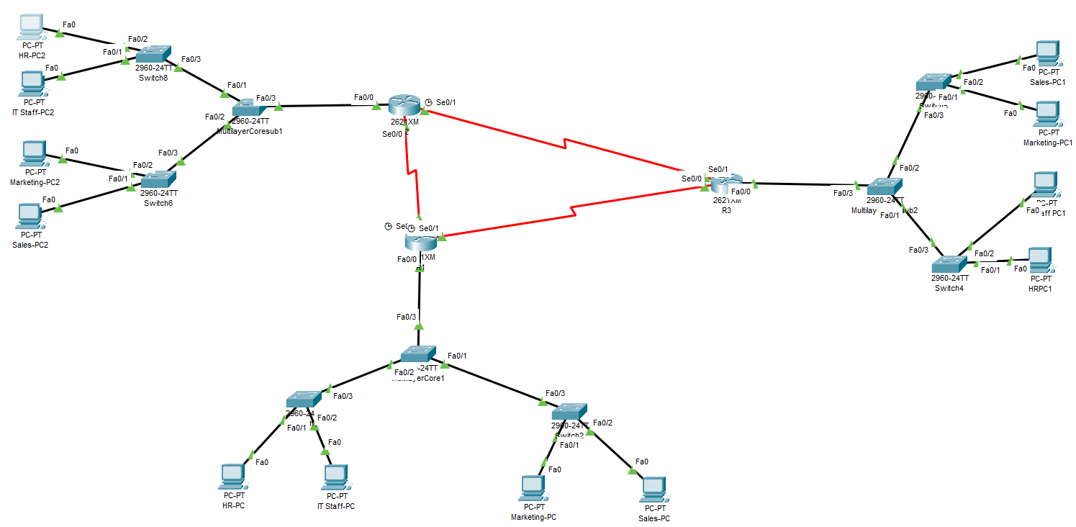

Slide 9
TIFFANY NGUYEN
2.
GNS3

Slide 10
GNS3
Good pricing – free to download
Needs Cisco IOS images to have properly functioning features
Not ideal to use in the classroom due to not being able to use Cisco IOS images without breaking Terms of Service
Great community documentation and learning tools on their website

Slide 11
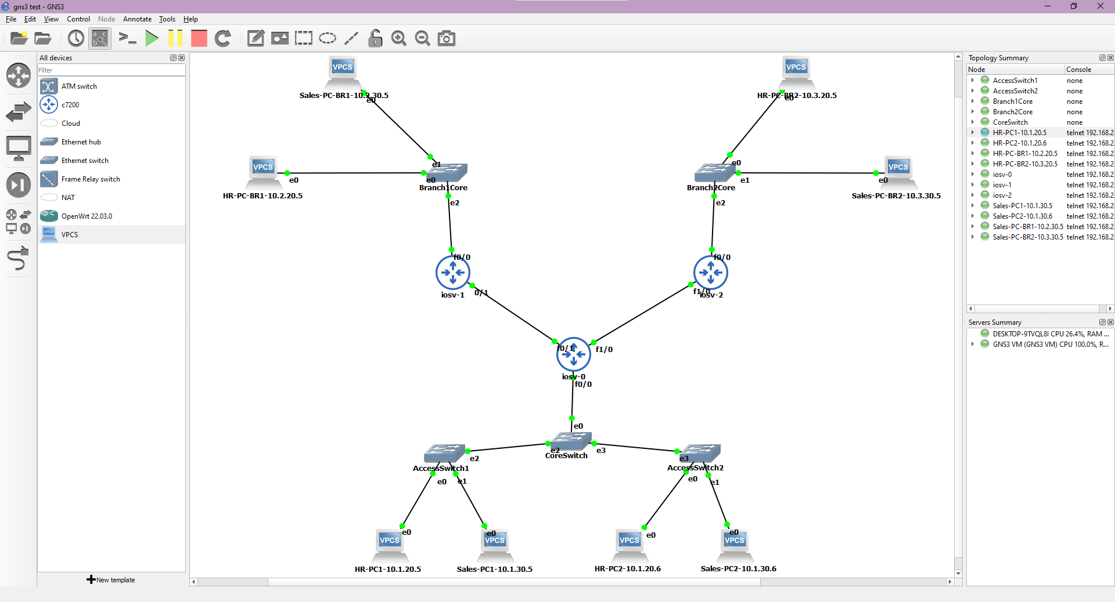

Slide 12
AZM UDDIN
3.
EVE-NG

Slide 13
EVE-NG
Community version and Professional version
Need windows 8 or above, 8 GB RAM and 4 cores CPU.
No links other than Ethernet interfaces.
Must need the images for the router and switches to get the full features.
Documentation is difficult to navigate.

Slide 14
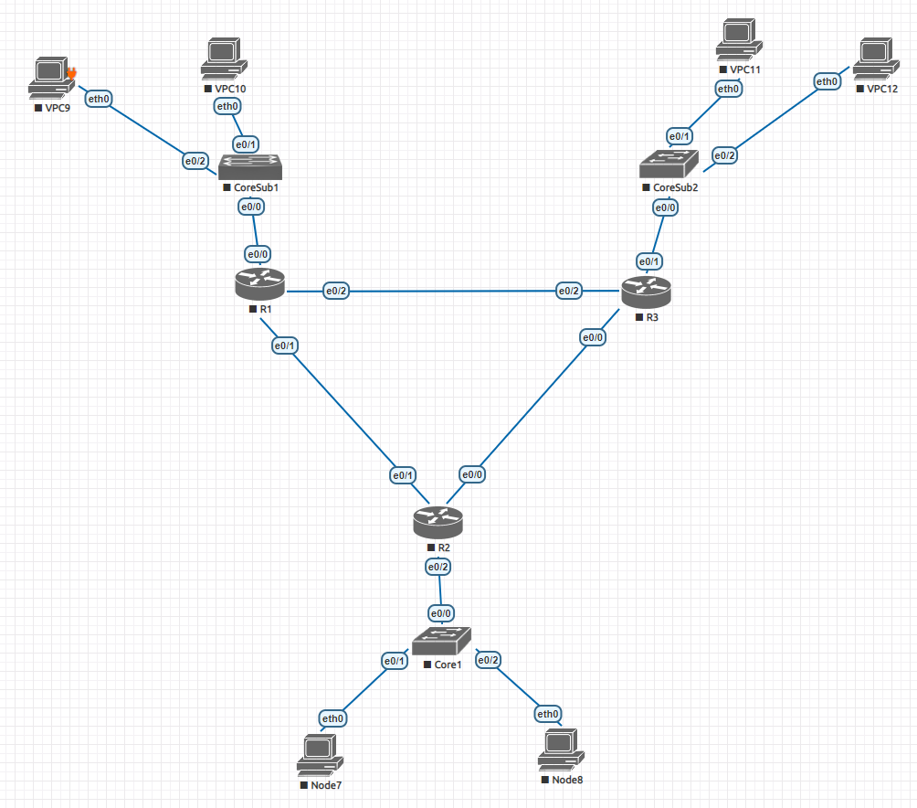

Slide 15
JUSTIN MCCANNON
4.
CISCO MODELING LABS

Slide 16
CISCO MODELING LABS
Successor to Cisco VIRL
Emulates software images derived from actual hardware
Images for Cisco IOS and Nexus devices included.
Available for $199 for an individual license. Enterprise/education options available.

Slide 17
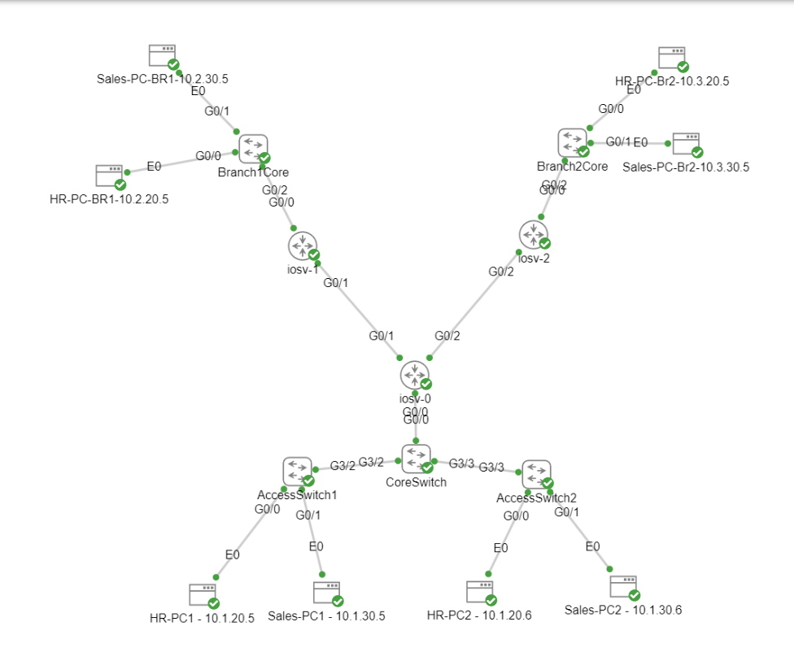

Slide 18
Final Ranking

Slide 19
Conclusions
Cisco Packet Tracer is the simulator of choice.
Team members have gained valuable experience to begin work on next phase.
Training materials used during testing will be used as a foundation for the final lab manual.

Slide 20
MEMBER CONTRIBUTIONS
Justin McCannon – Project Manager, Web Developer, Network Engineer
Nidhi Marsonia - Presentation Development, Research, Software Tester for Packet Tracer
Michael McInnis – Presentation Development, Analyst, Software Tester for Packet Tracer.
Tiffany Nguyen – Presentation Development, Research, Software Tester for GNS3
Azm Uddin - Presentation Development, Research, Software Tester for EVE-NG

Slide 21
Next Steps
Continue team meetings twice a week
Finalize research report
Finalize classroom manual for chosen network simulator
1
3
5
2
4
6
Distribute workload to team
Finalize presentation
Submit final deliverables

